Slide 1
Farm Cooperative

Slide 2
Use cases
Client manages members and keep track of outputs
Manager manages farms
Employees can grow/manage/harvest crops
Items
Order, notify, ship, deliver
Notes:
The client can manage members and keep track of their outputs.
The manager can manage farms.
Employees including managers can grow, manage and harvest crops.
Items, the manager orders items, then notifies the supplier, and if they have any in stock then it gets shipped to the manager.

Slide 3
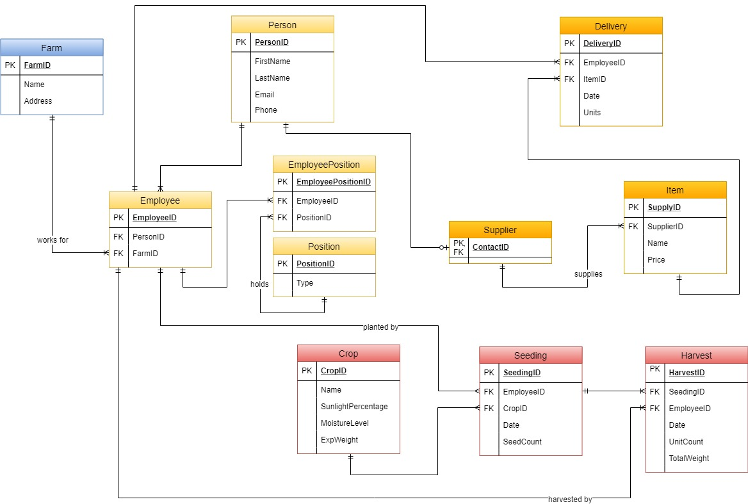
Schema
Farm
Employees
Crops
Seeding
Harvest
Items
Delivery

Slide 4
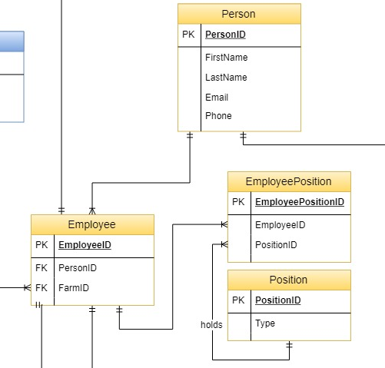
What tables did we add
Person
Employees
Notes:
Person
- Record details for each individual person
- Reduce code duplication
Employee
- Can have multiple positions

Slide 5

Item
Suppliers could offer different prices
Notes:
The reason why we have SupplierID in the Item table is because if the supplier has two same items but they have different prices

Slide 6
Harvest
SeedingID as primary key
Different employees harvest crops

